Slide 1
Searching
Md Mehrab Hossain Opi
CSE 4109: Artificial Intelligence

Slide 2
Artificial Intelligence
What is AI?
The Art of creating machines that perform functions that require intelligence when performed by people.
The ability to think and understand instead of doing things by instinct or automatically.

Slide 3
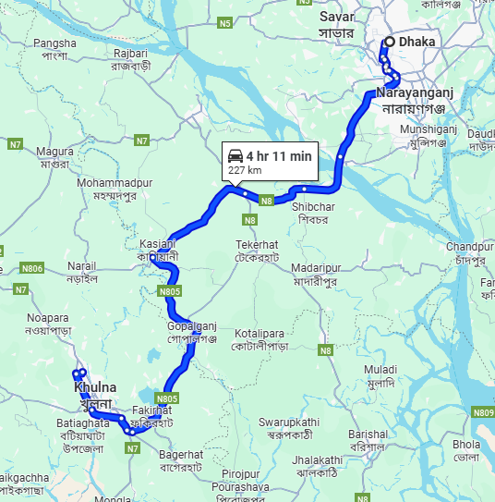
Artificial Intelligence
Do you think this is AI?

Slide 4
Searching in AI
AI is all about searching.
Searching for a solution of a given problem.
Or
Searching for the steps to complete a task.
Search for direction to reach a destination.
Search for an answer when asked in LLM(ChatGPT).
Search for the next step in chess to win the game.

Slide 5
Basic Terminology
Agent
An entity that perceives its environment and acts upon that environment.
A robot?
A car?
A human?
A game character?

Slide 6
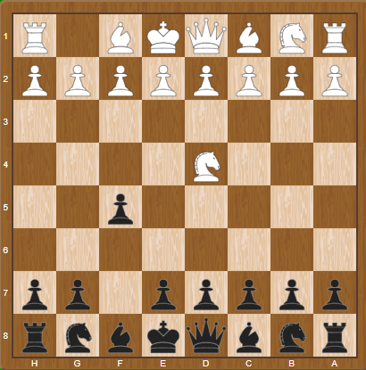
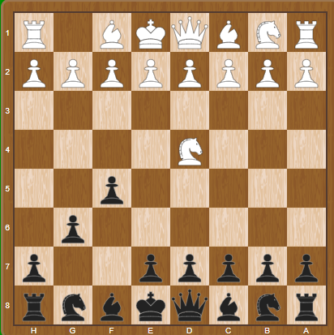
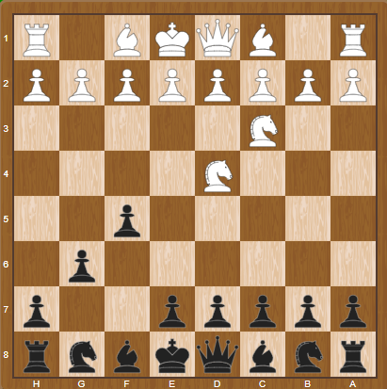
Basic Terminology
State
A state is a specific configuration of the agent and its environment at a given time.

Slide 7
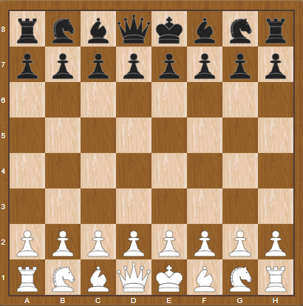
Basic Terminology
Initial State
The state in which the agent begins.

Slide 8
Basic Terminology
Actions
Choices that can be made in a state.
20 possible moves in the first move of a chess game.
ACTIONS(s)
A function that returns the set of actions that can be executed in state s.

Slide 9
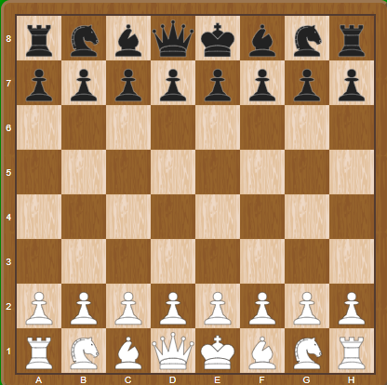
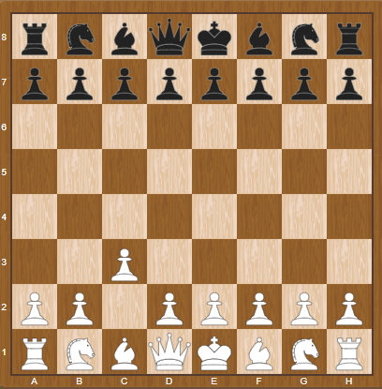
Basic Terminology
Transition Model
A description of what state results from performing any applicable action in any given state.
RESULT(s,a)
A function that returns the state resulting from performing action a in state s.
RESULT( , ‘c2c3’) =

Slide 10
Basic Terminology
State Space
The set of all states reachable from the initial state by any sequence of action.

Slide 11
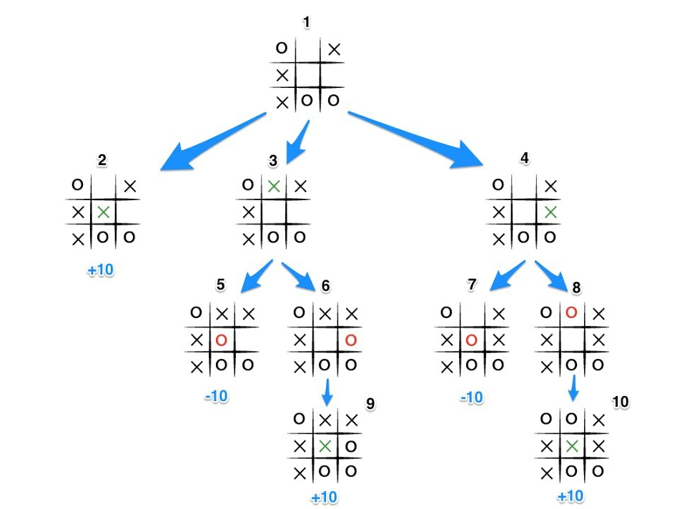
Basic Terminology
State Space

Slide 12
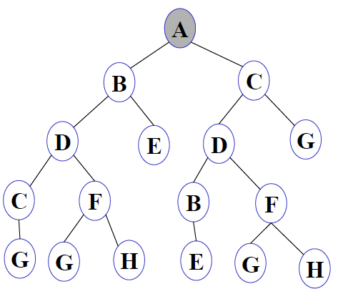
Basic Terminology
To simplify state space, we will represent each state with a simple node.

Slide 13


Basic Terminology
Goal Test
A way to determine whether a given state is a goal state.
Goal State ✅
Not a Goal State ❌

Slide 14
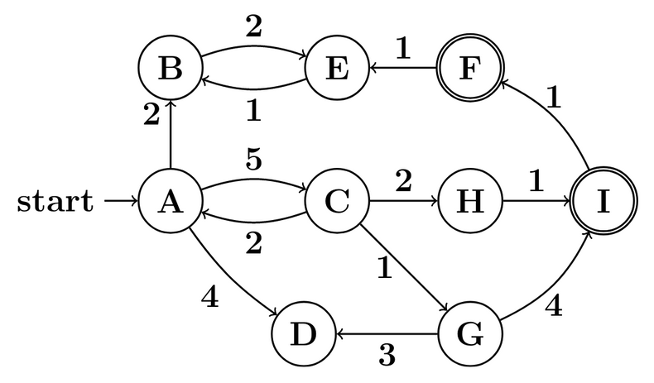

Basic Terminology
Path Cost
Path cost is the total cost of a sequence of actions from the initial state to the goal state.
Cost of$A−>C−>G−>D = 5+1+3=9$

Slide 15
Search Problem
A search problem is a formal representation of a problem that an AI agent can solve by exploring different states to reach a goal.
A search problem is defined by five elements:
Initial State
Actions
Transition Model
Goal Test
Path Cost Function

Slide 16
Search Problem Solution
Solution
A sequence of actions that leads from the initial state to a goal state.
Optimal Solution
A solution that has the lowest path cost among all solutions.

Slide 17
node
A node is a data structure that represents a state in the search tree, along with information needed to reconstruct the path taken to reach that state.
Each node typically stores:
State – the actual state in the problem domain.
Parent – The node from which this node was generated.
Action – the action taken to reach this state from the parent.
Path Cost – Cost from the initial state to this node.

Slide 18
General Approach
The goal of a search algorithm is to explore the state space starting from the initial state, using actions to generate new states, until it finds a goal state.
Steps:
Start with a frontier that contains the initial node.
‘frontier’ is a data structure that contains all the node we could explore next, that we haven’t explored yet.
2. Repeat:
3. If the frontier is empty, then no solution exists.
4. Remove a node from the frontier.
5. If node contains goal state return the solution.
6. Expand node, add resulting nodes to the frontier.

Slide 19
General Approach
Suppose the initial state is A and the goal state is D.
The goal of our search problem is to find a path from A to D.
Let’s apply the general approach.
A
B
E
C
D
F

Slide 20
General Approach
Frontier
B
C
E
D
A
F
A
1. Start with a frontier that contains the initial node.
2. Repeat:
3. If the frontier is empty, then no solution exists.
4. Remove a node from the frontier.
5. If node contains goal state return the solution.
6. Expand node, add resulting nodes to the frontier.
B
E
C
D
F

Slide 21
General Approach
1. Start with a frontier that contains the initial node.
2. Repeat:
3. If the frontier is empty, then no solution exists.
4. Remove a node from the frontier.
5. If node contains goal state return the solution.
6. Expand node, add resulting nodes to the frontier.
A
Will this algorithm work on this graph?
B
Is there any problem with this algorithm?
C

Slide 22
Revised Approach
Start with a frontier that contains the initial node.
Start with an empty set.
2. Repeat:
3. If the frontier is empty, then no solution exists.
4. Remove a node from the frontier.
5. If node contains goal state return the solution.
6. Add the node to the explored set.
7. Expand node, add resulting nodes to the frontier if they aren’t already in the frontier or the explored set.

Slide 23
Measuring Performance
Completeness
Is the algorithm guaranteed to find a solution when there is one?
Optimality
Does the strategy find the optimal solution?
Time Complexity
How long does it take to find a solution?
Space Complexity
How much memory is needed to perform the search?

Slide 24
Complexity in AI
Graph is often represented implicitly.
Initial state, actions and transition model.
Often infinite.
Traditional complexity doesn’t apply here.

Slide 25
Complexity in AI
Complexity is represented in terms of three quantities.
Branching factor(b)
Maximum number of successor of any node.
Depth of the shallowest goal(d)
The smallest number of steps needed to reach a goal from the root.
Maximum path length(m)
Longest sequence of actions without repeating state.

Slide 26
Complexity in AI
Time complexity is measured in number of nodes generated.
Space complexity is measured in maximum number of nodes stored in memory at any one time.

Slide 27
Effectiveness of Algorithm
Search Cost
Time spent computing the solution.
Milliseconds, CPU cycles, or node expanded.
Path Cost
Quality of the final solution in domain terms.
Money, distance, etc.
Total Cost = Search Cost + Path Cost

Slide 28
Thank You.

